Slide 1






SC1015
MINI PROJECT
Prediction of Song Popularity
Lab Group CSPT1, Team 3
HAU SIAN MUNG
IRA SYAKIRAH BINTE SALEHUDIN
KYI ZIN HMUE THANT

Slide 2

Current Situation
Based on the Luminate report in 2023,
120,000
NEW TRACKS RELEASED EVERYDAY
on streaming services

Slide 3

Problem Definition
Songs are not just melodies but a source of income for composers and producers.
The music industry is highly competitive, with numerous songs released daily, making it challenging to attract listeners and climb the charts.
Goal
Create a model to predict a song's popularity based on music data.
Assist composers and producers in creating popular songs by providing insights into the essential features.

Slide 4


EDA
Filtered key variables that can influence the popularity of a song
Exploratory Data Analysis
energy
loudness
valence
liveness
danceability
instrumentalness
acousticness

Slide 5
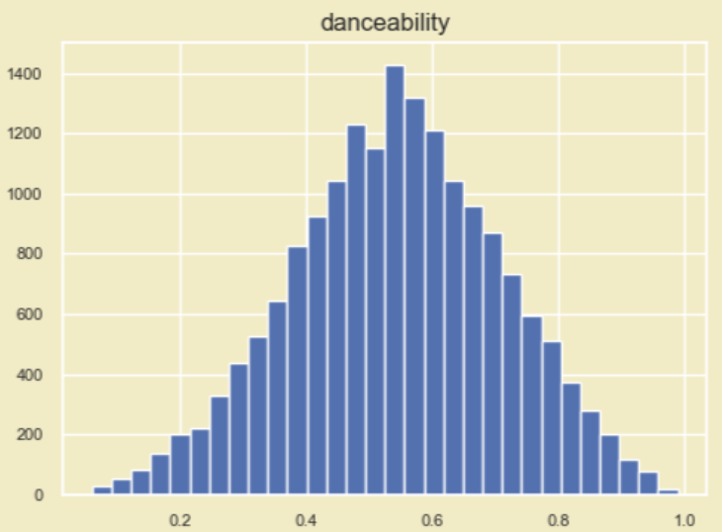
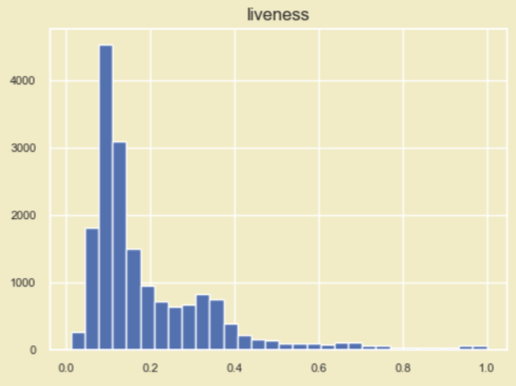
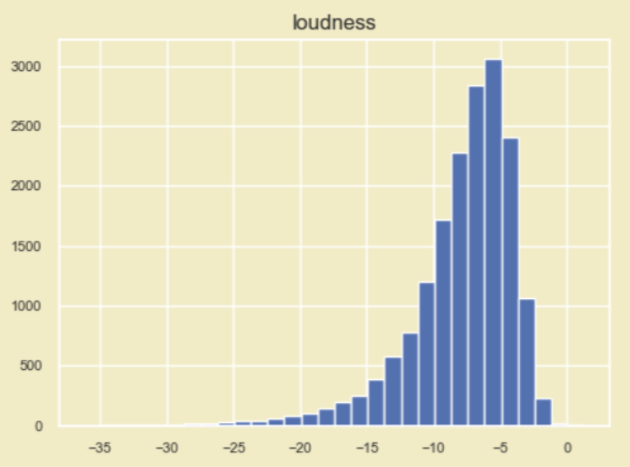
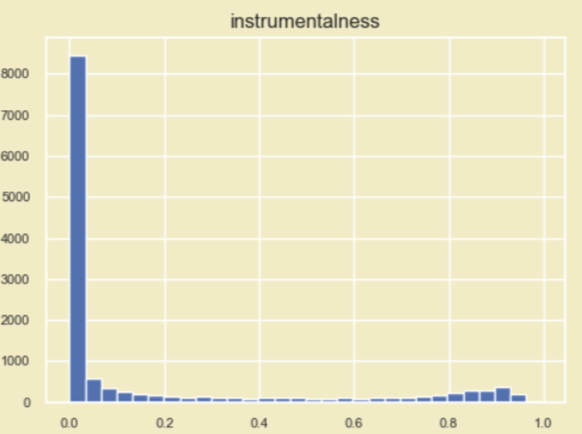
EDA
Conducted individual analyses of each variable using bar plots to visualize data distribution and skewness.
Exploratory Data Analysis
Most tracks have low instrumentalness, while very few tracks have high instrumentalness
Distribution for danceability is close to normal
Liveness has right-skewed distribution
Loudness has a left-skewed distribution

Slide 6
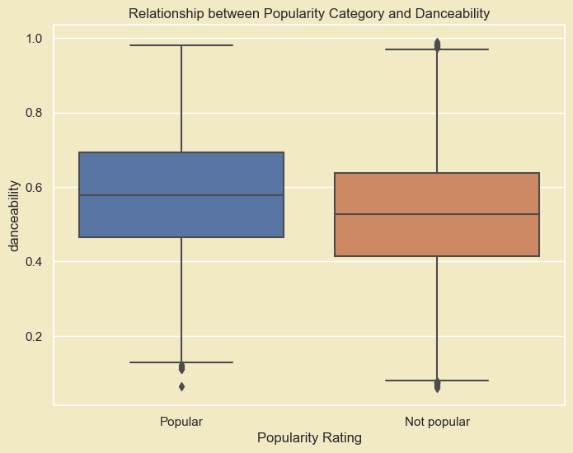
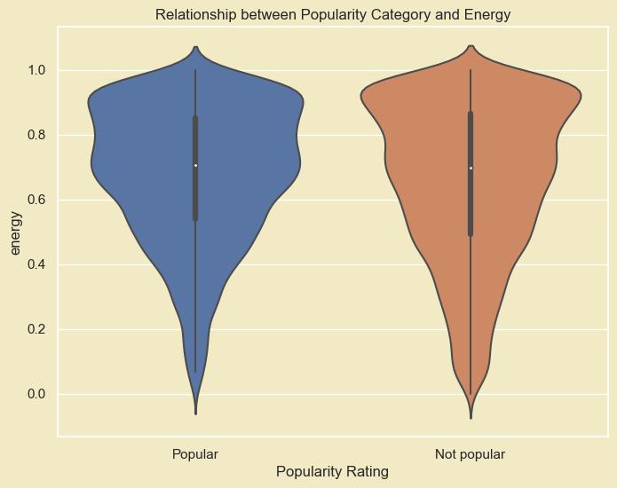
EDA
Explored relationships between variables like danceability, energy, and popularity to identify key predictors.
Exploratory Data Analysis
Popular songs has the interquartile range of danceability spans from 0.5 to 0.7, indicating that 50% of the data falls within this range.
Not Popular shows a broader distribution of energy levels
Popular songs mostly have energy level of around 0.5 and higher

Slide 7
EDA
Data Cleaning
Exploratory Data Analysis
Replaced null with its respective mean values
Removed outliers
Mapped numerical genre values to its corresponding genre names
Replaced NaN values with respective mean values

Slide 8
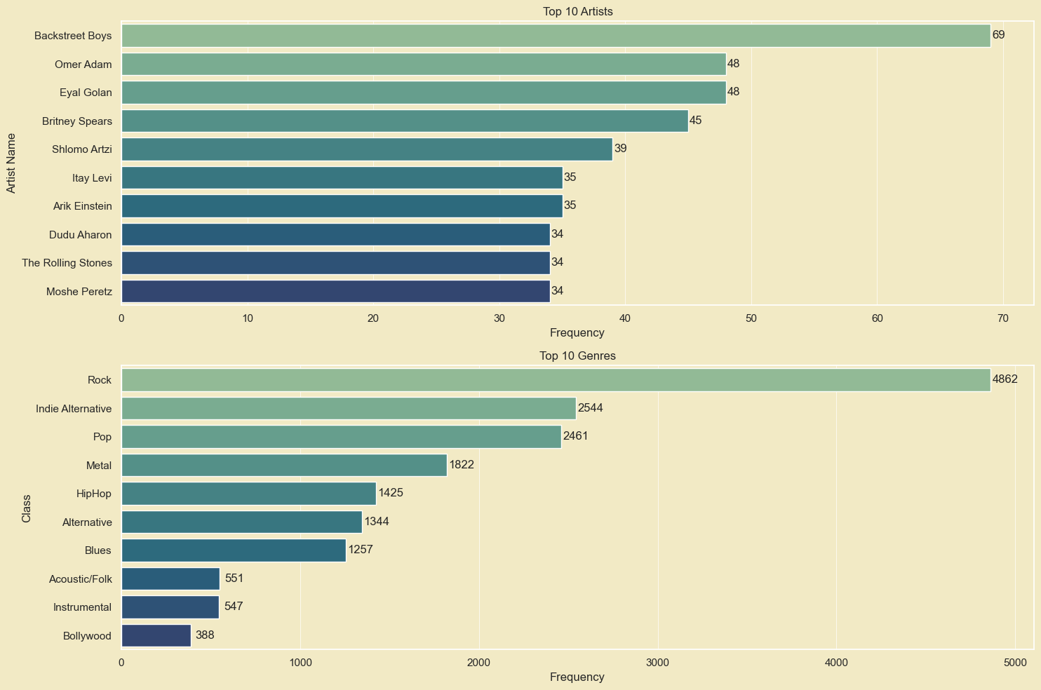
EDA
Explored Top Artists and Genres
Exploratory Data Analysis
Showcases which artists have the highest number of songs in our dataset.
Backstreet Boys emerges at the top with 69 of their songs listed in the dataset.
Frequency distribution of different genres in our dataset.
Rock emerges as the dominant genre, with a significantly higher frequency compared to others.

Slide 9
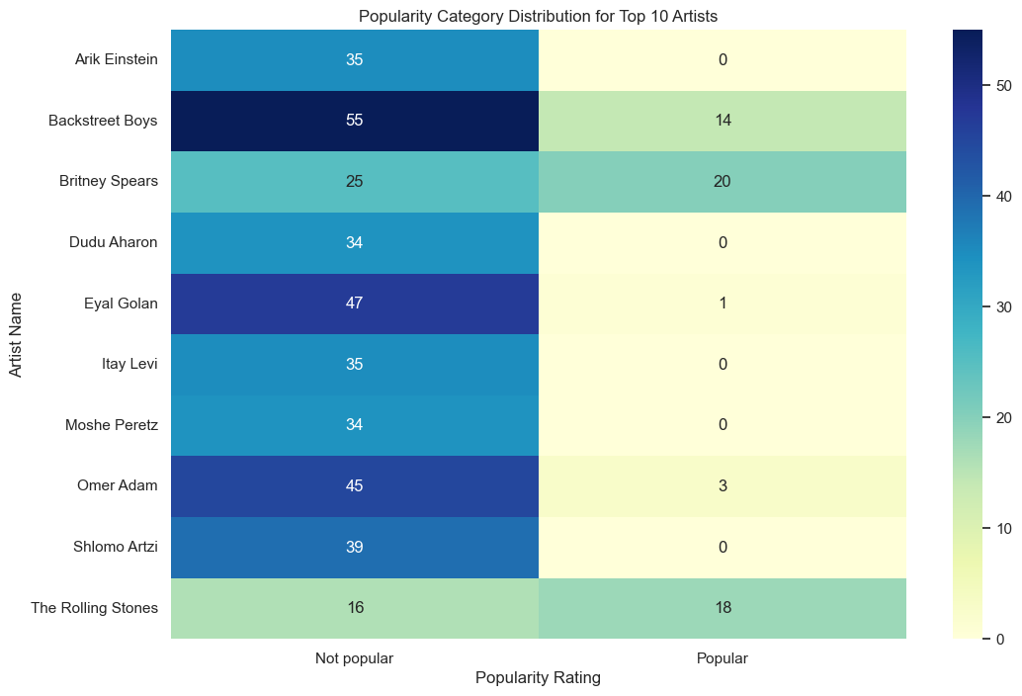
EDA
Popularity Category for Top 10 Artists
Exploratory Data Analysis
Heatmap to explore the relationship between the top 10 artists and the popularity category.
Backstreet Boys has 69 songs listed in the dataset but only 14 are rated Popular.
The Rolling Stones have 18 Popular songs and 16 Not popular songs, indicating a more balanced distribution.

Slide 10

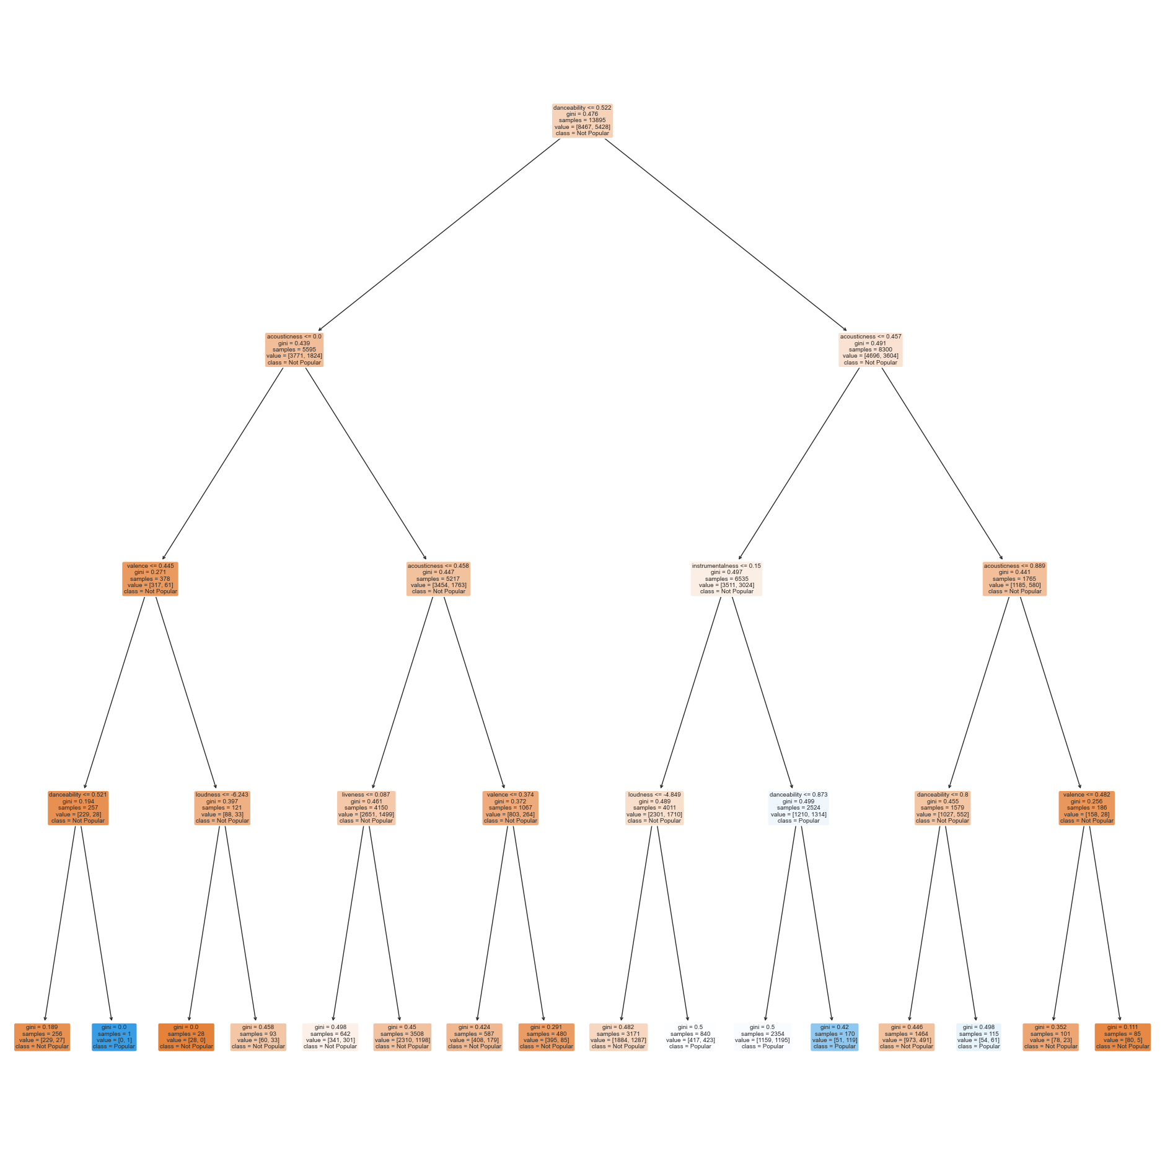
Machine Learning
Model Training and Evaluation using Train Data
Method:
Multi-Variate Classification Tree
Choice of Multi-Variate Method:
Opted for multi-variate approach to improve correlation between "Popularity" and multiple variables, aligning with our objective.
Data Cleaning:
Outliers removed and null values replaced to ensure quality dataset for training.
Model Training:
Employed Decision Tree Classifier from "sklearn" library for model training.

Slide 11
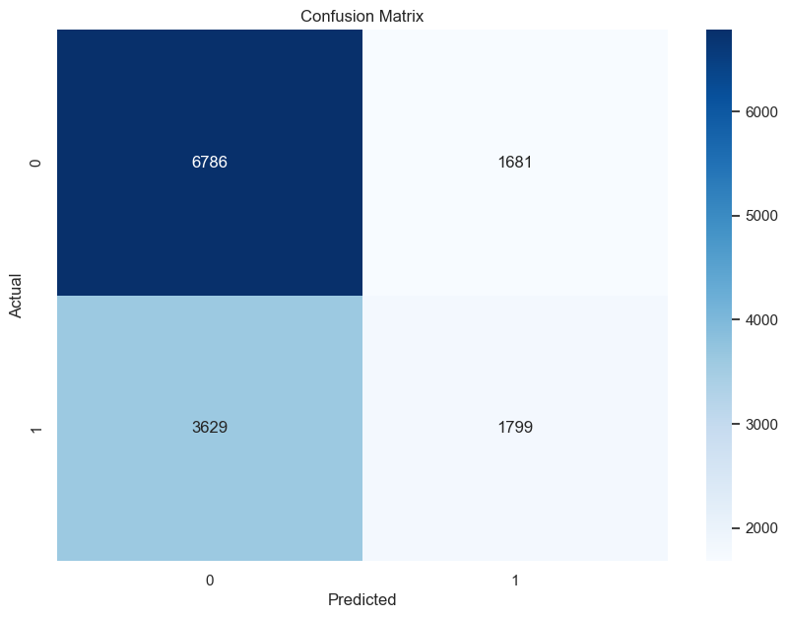
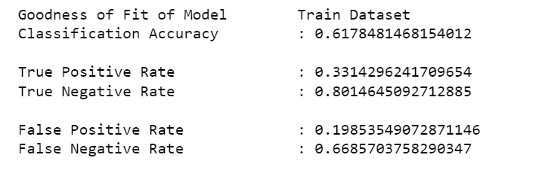
Machine Learning
Model Training and Evaluation using Train Data
Test Data Preparation:
Conducted data preprocessing on test data to enhance prediction accuracy.
Prediction and Evaluation:
Predicted "Popularity" of songs based on characteristics and evaluated using Confusion Matrix.
Insights Derived:

Slide 12
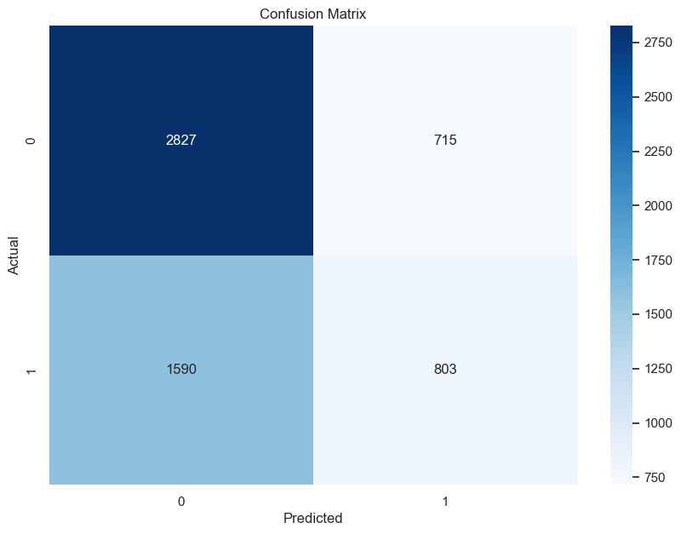
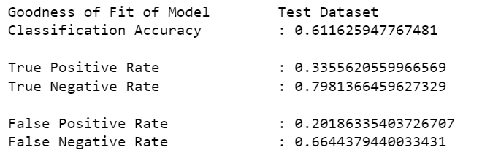
Machine Learning
Model Training and Evaluation using Test Data
Test Data Preparation:
Conducted data preprocessing on test data to enhance prediction accuracy.
Prediction and Evaluation:
Predicted "Popularity" of songs based on characteristics and evaluated using Confusion Matrix.
Insights Derived:

Slide 13

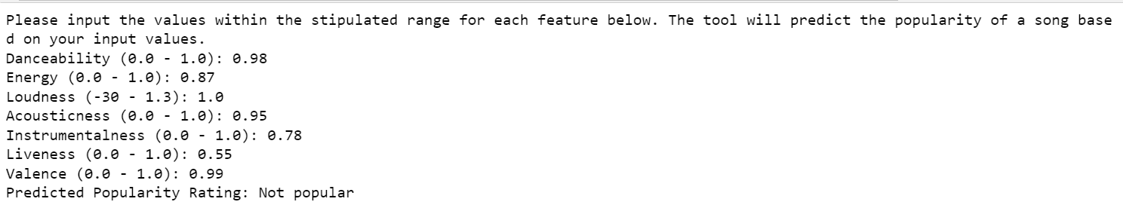
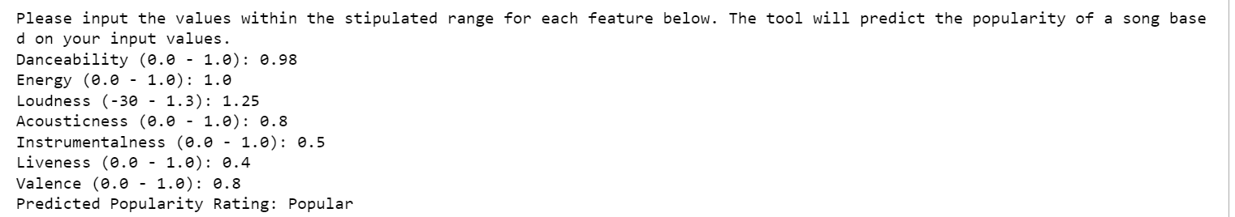
Outcome
Model Training and Evaluation using Test Data
Tool was developed to allow users to input the values for the different music variables
Tool will predict the popularity of the song based on the user input using the trained model

Slide 14

Data-driven Insights
and Recommendations
Data-driven Insights:
The popularity of a song is not influenced by only a single variable. A mixture of attributes is required to influence its popularity rating.
Rock, Pop and Hip hop genre songs are fairly distributed between the Not Popular and Popular categories.
Country has significantly more songs falling into the Popular category compared to the Not Popular category.
Releasing many songs does not guarantee that your subsequent songs can be a hit
Recommendation:
Combining multiple attributes and getting the right range will enhance the possibility of a song to be a hit.

Slide 15
Thank You

